Slide 1
User Behavior Analysis in Social Networks: Pattern Discovery, Prediction and Anomaly Detection
Meng Jiang 蒋 朦
www.meng-jiang.com

Slide 2
My Group in Tsinghua
Professor Jianping Wu (Network) Professor Maosong Sun (NLP)
Professor Yuanchun Shi (HCI) Professor Shimin Hu (Graphics)
Professor Shiqiang Yang (Multimedia) Professor Jiangtao Wen (Net-of-Things) Professor Lifeng Sun (Multimedia)
Professor Wenwu Zhu (Multimedia) Assistant Professor Peng Cui (DM & Multimedia)
Department of Computer Science and Technology
Institute of HCI and Media Integration
Lab of Multimedia and Networking
Social Media Lab

Slide 3
Social-sensed Multimedia Computing
Social Network (DM)
Microscope
Behavior Analysis
Macroscope
Information Diffusion
Multimedia
Media and Human
Emotion Detection
Image Search
Behavior analysis
Pattern discovery and prediction [KDD’14]
Social recommendation [CIKM’12, CIKM’12, TKDE’14]
Anomaly detection [PAKDD’14, WWW’14 Poster, KDD’14]
Information diffusion
Item-level influence [AAAI’11, SIGIR’11]
Outbreak detection [KDD’13]
Big social data
Heterogeneous hashing [KDD’13]
Multimedia computing [TMM’09, DMKD’11, TIP’12, TMM’12, MM’12 Best, TOMCCAP’13, TOMCCAP’14]
Image search [MMM’13 Best, TOIS’14, CVIU’14]
Emotion detection [MM’13, ICMR’14]

Slide 4
Social-sensed Multimedia Computing
Social Network (DM)
Microscope
Behavior Analysis
Macroscope
Information Diffusion
Multimedia
Media and Human
Emotion Detection
Image Search
Behavior analysis
Pattern discovery and prediction [KDD’14]
Social recommendation [CIKM’12, CIKM’12, TKDE’14]
Anomaly detection [PAKDD’14, WWW’14 Poster, KDD’14]
Information diffusion
Item-level influence [AAAI’11, SIGIR’11]
Outbreak detection [KDD’13]
Big social data
Heterogeneous hashing [KDD’13]
Multimedia computing [TMM’09, DMKD’11, TIP’12, TMM’12, MM’12 Best, TOMCCAP’13, TOMCCAP’14]
Image search [MMM’13 Best, TOIS’14, CVIU’14]
Emotion detection [MM’13, ICMR’14]

Slide 5
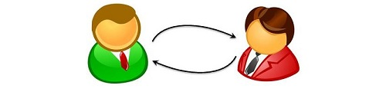
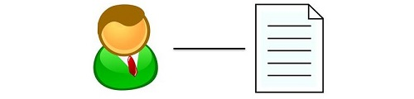


My Research Interests
User-user link
User-item link
Normal use
Anomalous use

Slide 6
My Research Interests
 | Influence mining Community detection Friend recommendation
User-user link
User-item link
Normal use
Anomalous use

Slide 7
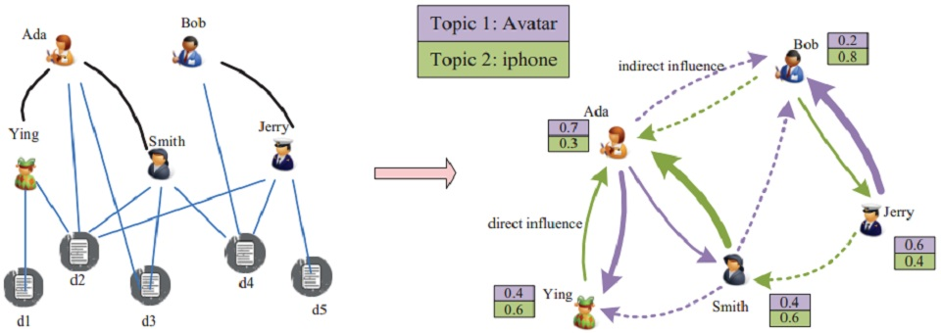
My Research Interests
User-user link
User-item link
Topic-level influence [Liu et al. CIKM 2010]
Normal use
Anomalous use

Slide 8
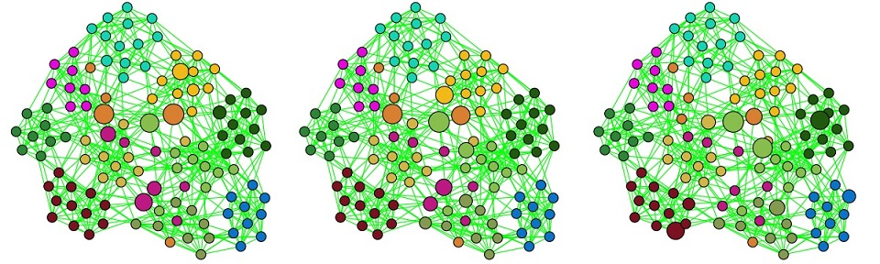
My Research Interests
User-user link
User-item link
User diversity [Lu et al. Multimed Tools Appl 2012]
Normal use
Anomalous use

Slide 9
My Research Interests
 |  | Behavior prediction Social recommendation Behavior pattern discovery
User-user link
User-item link
Normal use
Anomalous use

Slide 10
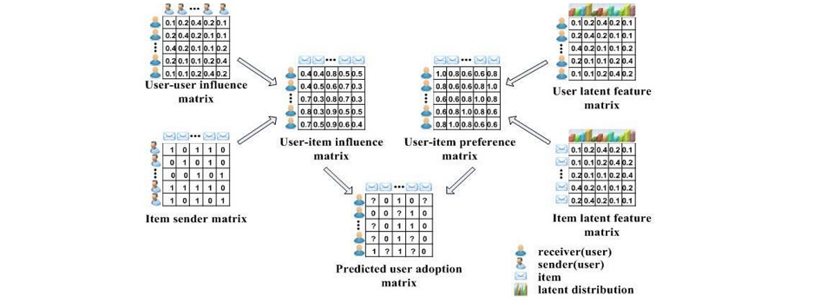
My Research Interests
User-user link
User-item link
Social contextual recommendation [Jiang et al. CIKM 2012]
Normal use
Anomalous use

Slide 11
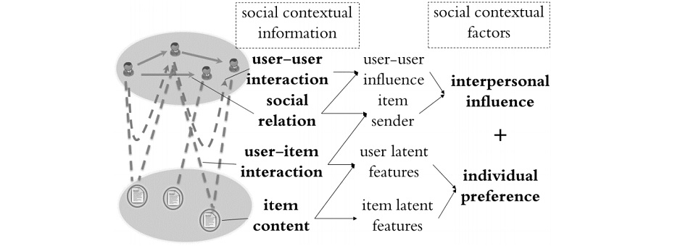
My Research Interests
User-user link
User-item link
Scalable recommendation with social context
[Jiang et al. TKDE 2014]
Normal use
Anomalous use

Slide 12
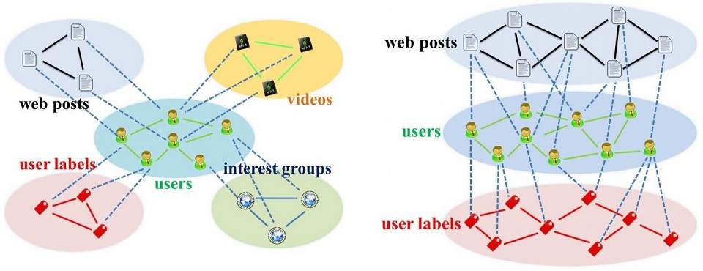
My Research Interests
User-user link
User-item link
Cross-domain social recommendation [Jiang et al. CIKM 2012]
Normal use
Anomalous use

Slide 13
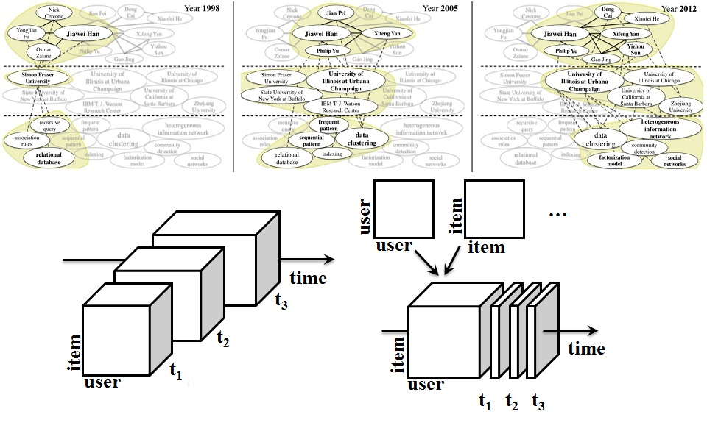
My Research Interests
User-user link
User-item link
Behavior modeling and pattern discovery [Jiang et al. KDD 2014]
Normal use
Anomalous use

Slide 14
My Research Interests
 | Zombie follower detection Suspicious behavior patterns
User-user link
User-item link
Normal use
Anomalous use

Slide 15
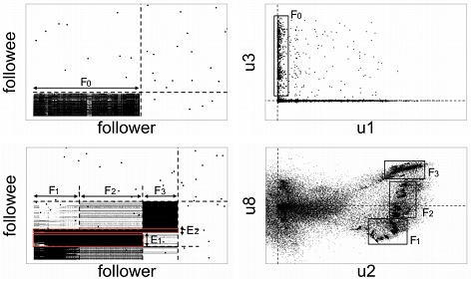
My Research Interests
User-user link
User-item link
Dense bipartite core detection [Jiang et al. PAKDD 2014]
Normal use
Anomalous use

Slide 16
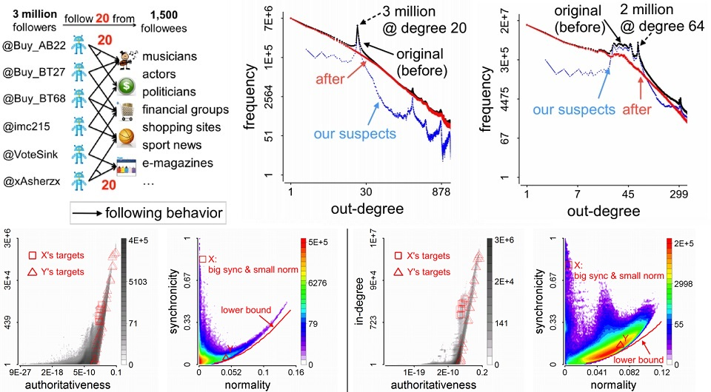
My Research Interests
User-user link
User-item link
Zombie follower detection
[Jiang et al. WWW 2014 Poster, KDD 2014]
Normal use
Anomalous use

Slide 17
My Research Interests
 |  | Spam/fraud detection Promoting behavior patterns [On-going]
User-user link
User-item link
Normal use
Anomalous use

Slide 18

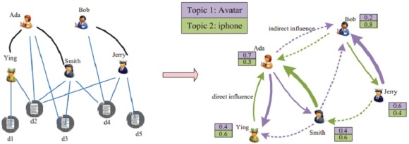
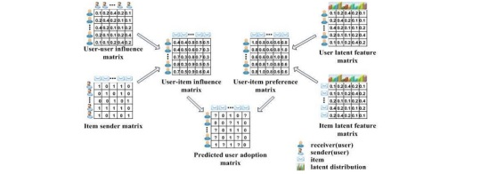
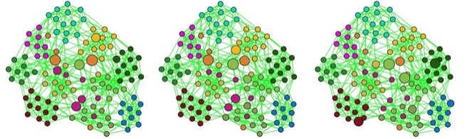
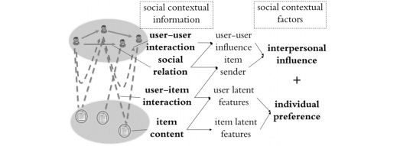

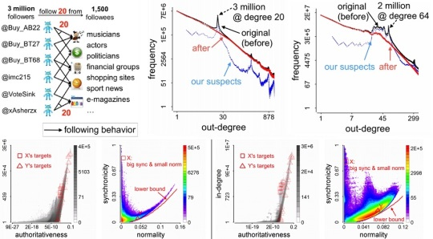
My Research Interests
User-user link
User-item link
Normal use
Behavior analysis
Pattern discovery and prediction [KDD’14]
Social recommendation [CIKM’12, CIKM’12, TKDE’14]
Anomaly detection [PAKDD’14, WWW’14 Poster, KDD’14]
Anomalous use

Slide 19
Outline
Social contextual recommendation [CIKM’12+TKDE’14]
Cross-domain social recommendation [CIKM’12]
Behavior discovery and prediction [KDD’14]
Dense bipartite core detection [PAKDD’14]
Zombie follower detection [KDD’14]
Good user-item links
Bad user-user links

Slide 20
Outline
Social contextual recommendation [CIKM’12+TKDE’14]
Cross-domain social recommendation [CIKM’12]
Behavior discovery and prediction [KDD’14]
Dense bipartite core detection [PAKDD’14]
Zombie follower detection [KDD’14]
Good user-item links
Bad user-user links

Slide 21






Social Recommendation
Problem
Too many messages are generated and received every minute.
How to recommend posts/rank feeds in social networks?
Challenges
High sparsity for user-item matrix factorization/completion
 | User 1 | User 2 | … | User M
Post 1 | 1 | 1 | … | 1
Post 2 | 0 | ? | … | ?
… | … | … | …
Post N | 1 | ? | … | 1

Slide 22
Social Contextual Information
More knowledge! But …
Can we use social relations (user-user links) to help infer missing user-item links?
Can we fully use social contextual information on the networks?
Bob
social relation
Amy
Tom
user-user
interaction
Nick
user-item
interaction
item content
Post 1
Post 3
Post 2

Slide 23
Related Works
Content-based filtering
Collaborative filtering
Bob
Amy
Tom
Nick
user-item
interaction
item content
Post 1
Post 3
Post 2

Slide 24
Related Works
Content-based filtering
Collaborative filtering
Trust-based recommendation
Influenced-based recommendation
Bob
Amy
Tom
user-user
interaction
Nick
user-item
interaction
Post 1
Post 3
Post 2

Slide 25
Related Works
Content-based filtering
Collaborative filtering
Trust-based recommendation
Influenced-based recommendation
Social recommendation with MF/Social Regularization
Bob
social relation
Amy
Tom
Nick
user-item
interaction
item content
Post 1
Post 3
Post 2

Slide 26
Related Works
 | Social relation | User-user interaction | User-item interaction | Item content
Content-based & CF | × | × | √ | √
Trust & Influence | × | √ | √ | ×
SoRec & SoReg | √ | × | √ | √
? | √ | √ | √ | √
How to fully use contextual information for social recommendation?
Answer: Understand user intention of adopting messages.

Slide 27

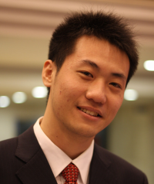
User Intention of Adopting Messages
Peng Cui : Is there anyone who call for paper via Renren? Hah!
http://media.cs.tsinghua.edu.cn/~multimedia/cuipeng/IR_SI_SocialMedia.htm
2011-01-05 13:47 Reply | Share
Call for paper? About social media? Wow!
Personal Preference
This is my best friend and co-author!
Interpersonal influence
Meng Jiang : Support! //Peng Cui : Is there anyone who call for paper via Renren? Hah!
http://media.cs.tsinghua.edu.cn/~multimedia/cuipeng/IR_SI_SocialMedia.htm
2011-01-05 14:05 Reply | Share

Slide 28
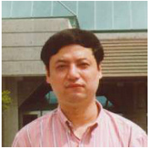
User Intention of Adopting Messages
Maosong Sun : KDD Summer School on Mining the Big Data will be held in Tsinghua. This is the first time for KDD to hold Summer School. Dean Xiaoyong Du, Dr. Hang Li and me are the Chairs. Today Jiawei Han(UIUC), Christos Faloutsos(CMU) and Bing Liu(UIC) gave lectures for 2 hours each.
2012-08-10 21:47 Retweet | Save | Reply
Amazing! Summer school! It is KDD!
Jiawei Han! Christos Faloutsos! Bin Liu!
Personal Preference
This is the Dean of my Department!
His research area is Artificial Intelligence and Data Mining!
Interpersonal influence
Meng Jiang : Amazing! //Maosong Sun : KDD Summer School on Mining the Big Data will be held in Tsinghua. This is the first time for KDD to hold Summer School. Dean Xiaoyong Du, Dr. Hang Li and me are the Chairs. Today Jiawei Han(UIUC), Christos Faloutsos(CMU) and Bing Liu(UIC) gave lectures for 2 hours each.
2012-08-11 09:35 Retweet | Save | Reply

Slide 29
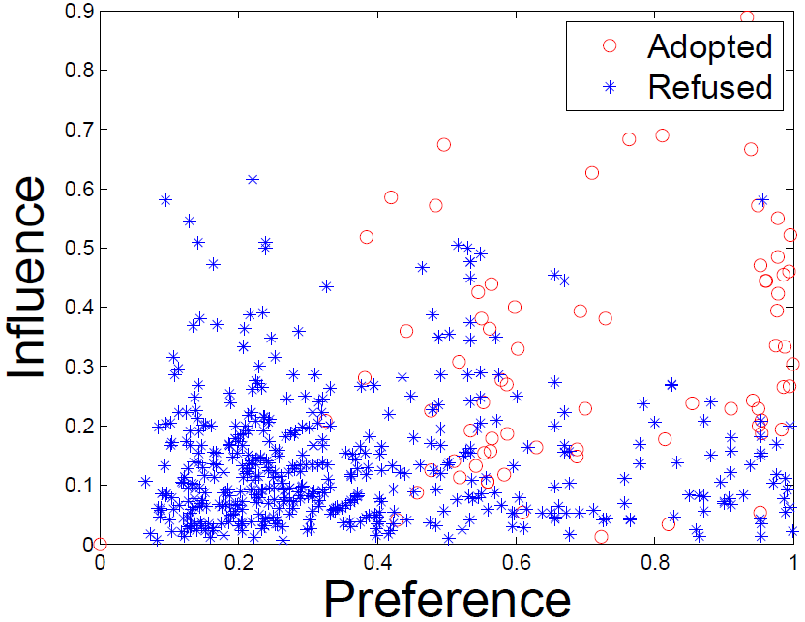
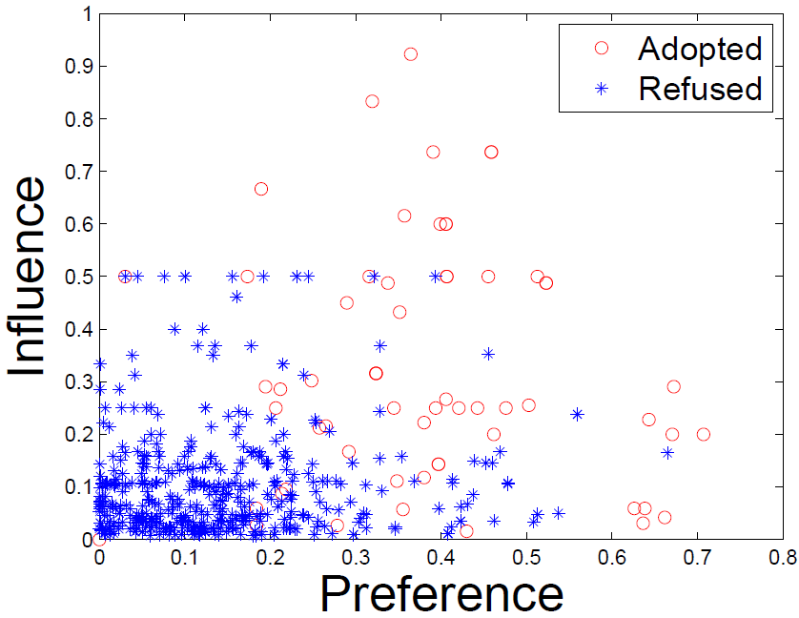
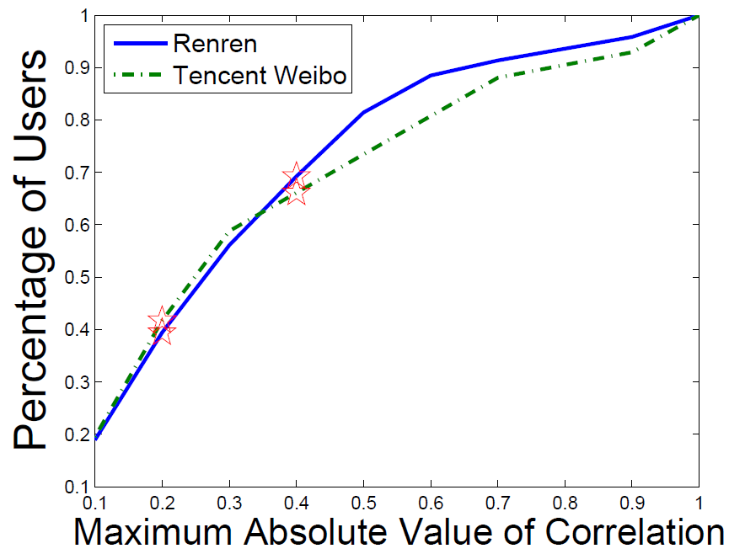
User Intention of Adopting Messages
Do we care the item content? Do we care the sender?
Preference: topic-level user-item similarity
Influence: user-sender interaction frequency
Renren
Tencent Weibo
Correlation(Preference,
Influence) is small.

Slide 30
Framework: Social Contextual Factors
item content
item latent feature V
user preference on given item
user-item interaction
user latent feature U
social relation
item sender G
social influence from sender of given item
user-user interaction
user-user influence S

Slide 31
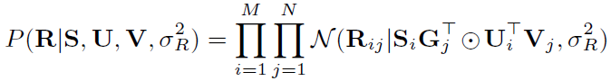
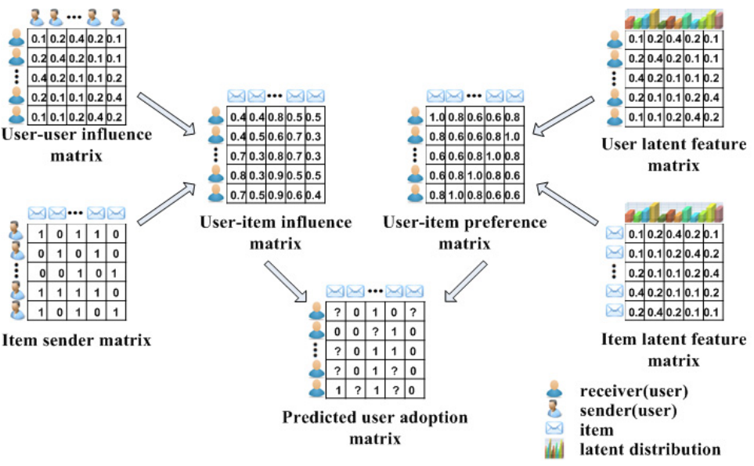
Framework: Social Contextual Factors
S
U
G
V
R

Slide 32
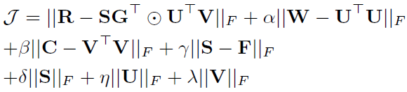
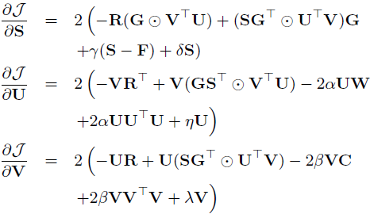
ContextMF Algorithm
Minimize sum-of-squared errors function
Block coordinate descent scheme with gradients.

Slide 33
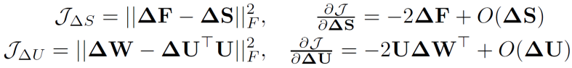
New Users and New Items Coming
New data = Entries between… | Old N items | New ΔN items
Old M users | Done! O(k²L(M+N)²) | O(k²LΔNN) << O(k²LN(M+N))
New ΔM users | O(k²LΔMM) << O(k²LM(M+N)) | Sorry…

Slide 34
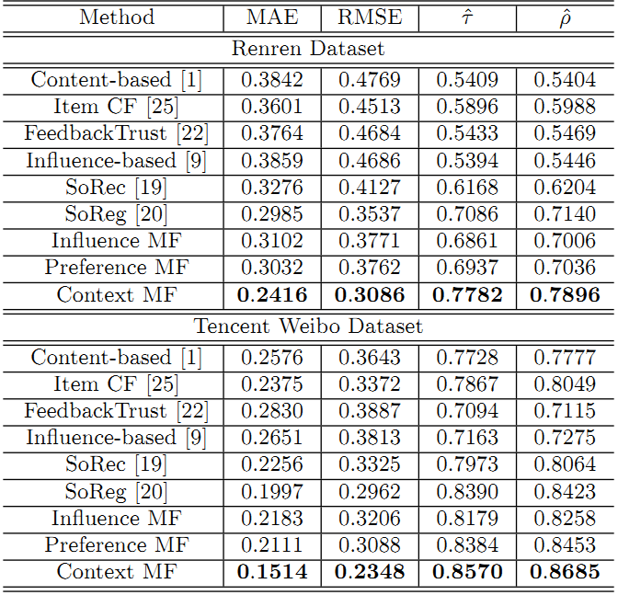
Effectiveness in Predicting Adoptions
 | Renren | Tencent Weibo
MAE | -19.1% | -24.2%
RMSE | -12.8% | -20.7%
Kendall’s | +9.82% | +2.1%
Spearman’s | +10.6% | +3.1%

Slide 35
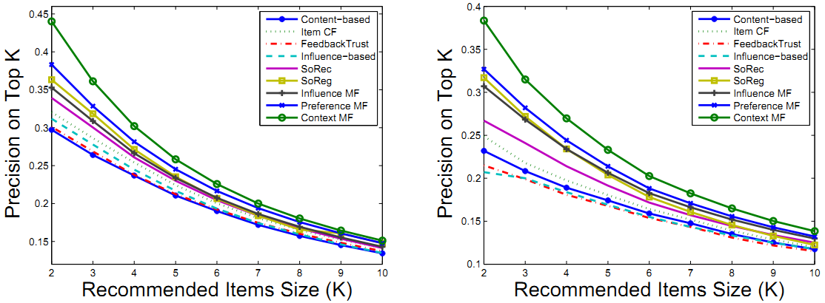
Effectiveness in Predicting Adoptions
ContextMF
ContextMF
Renren
Tencent Weibo
 | Renren | Tencent Weibo
Top-5 Precision | +21.7% | +12.3%
Top-10 Precision | +10.8% | +6.85%

Slide 36
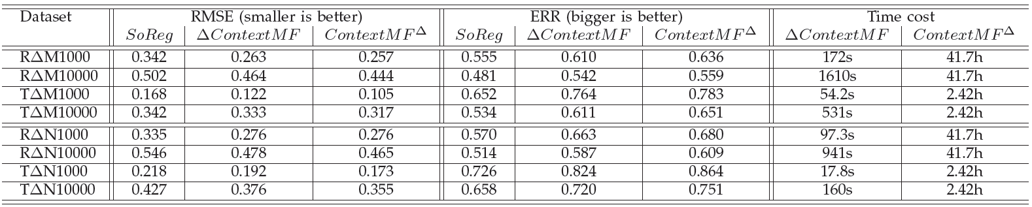
Efficiency in Incremental Data
Better than SoReg [Ma et al. WSDM 2011]
A little bit worse than offline learning (re-training)
Save time from hours to minutes when M,N ~ million and ΔM,ΔN ~ thousand
Meng Jiang, Peng Cui, Rui Liu, Qiang Yang, Fei Wang, Wenwu Zhu and Shiqiang Yang. Social Contextual Recommendation. The 21st ACM International Conference on Information and Knowledge Management (CIKM), 2012.
Meng Jiang, Peng Cui, Fei Wang, Wenwu Zhu and Shiqiang Yang. Scalable Recommendation with Social Contextual Information. IEEE Transactions on Knowledge and Data Engineering (TKDE), 2014.

Slide 37
Outline
Social contextual recommendation [CIKM’12+TKDE’14]
Cross-domain social recommendation [CIKM’12]
Behavior discovery and prediction [KDD’14]
Dense bipartite core detection [PAKDD’14]
Zombie follower detection [KDD’14]
Good user-item links
Bad user-user links

Slide 38


Social Recommendation
Problem
Usually we train historical behavioral data (user-post links) to understand their interests. However, if history ~ 0?
How can we recommend posts for new(-registered) users?
Challenges
Cold-start and extremely high sparsity in user-item domain
web posts
high sparsity
users

Slide 39
Social Recommendation
We have social relation domain.
We also have auxiliary knowledge in other domains.
User label domain
Choose < 10 from 200+ labels like ‘iPhone fan’
Peng Cui
Haidian, Beijing
Company: Tsinghua
User labels (5)
Tsinghua, Ph.D., World Wide Web,
Social Network, Social Media
Meng Jiang
Haidian, Beijing
University: Tsinghua
User labels (9)
Chinese food, World Wide Web,
Social Network, Data Mining, Liverpool Football Club, NBA, Humors, Sports, Ph.D. Candidates

Slide 40

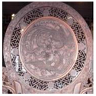

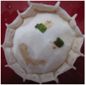
Social Recommendation
We have social relation domain.
We also have auxiliary knowledge in other domains.
Interest group domain
Interest Groups (2)
Interest Groups (3)
Tsinghua University
I love sing!
Tsinghua University
Social Media & Reputation
World Wide Web Team

Slide 41

Social Recommendation
How to construct social network with multiple domains?
We have user-post, user-label and user-group links.
No relations between item domains. No post-label links in nature.
Stronger social relations can help collaborate user-item links.
More collaborating in user-item links can strengthen the social relations.
web posts
web posts
users
users
?
?
?
user labels
user labels

Slide 42
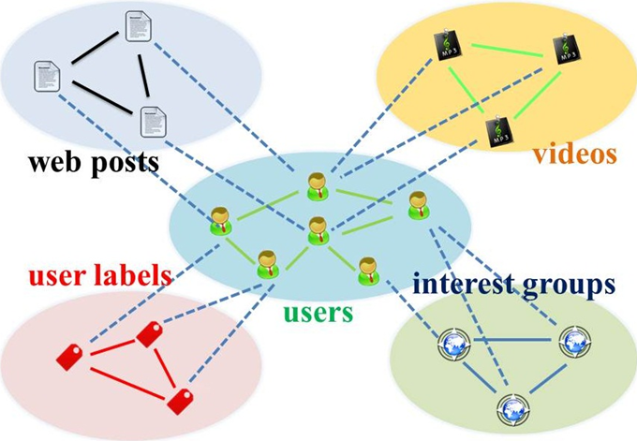
Social Recommendation
Answer: A star-structured graph.
Properties
Relational
Within-domain and cross-domain
Heterogeneous
Different types of item domains
Sparse
Different sparsity levels
Key idea
Use social relation domain as a bridge
Method
Transfer learning + Random walk with restarts

Slide 43
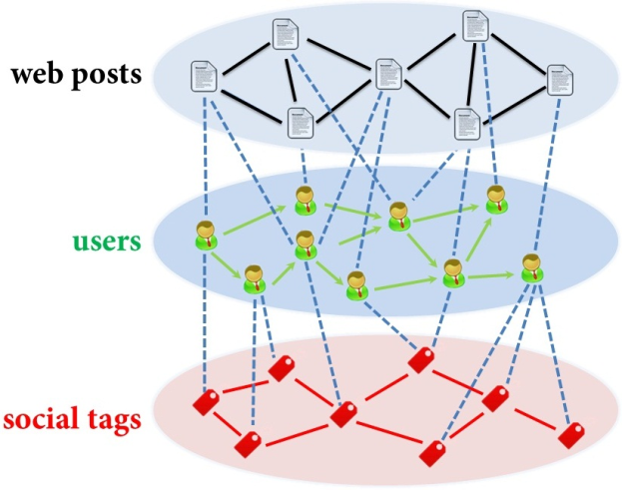
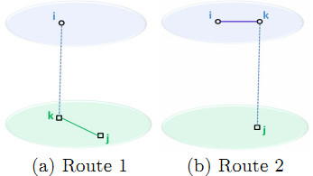
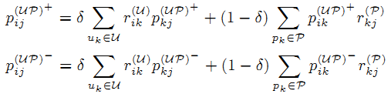
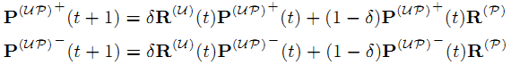
Hybrid Random Walk
On second-order star-structured graph
Update cross-domain links

Slide 44
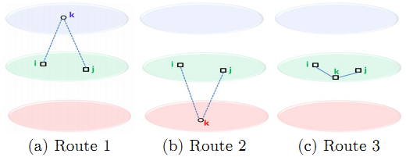
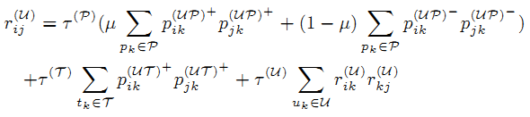
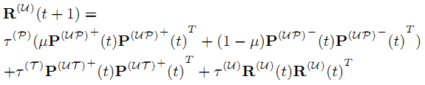
Social Recommendation
Update within-domain links

Slide 45
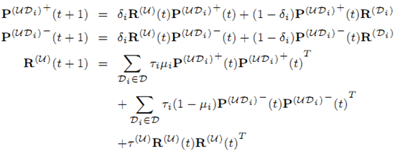
Social Recommendation
On high-order star-structured graph

Slide 46
Data Set
Tencent Weibo (January 2011)
Domain | Size | Cross-domain links
 |  | Accept | Refuse
User | 53.4K | — | —
Web post | 142K | 1.47M (0.02%) | 3.40M (0.04%)
User label | 111 | 330K (5.57%) | —

Slide 47
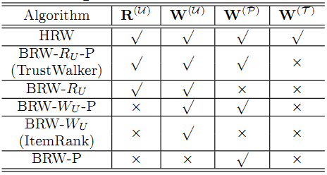
Good to Transfer?
Comparative Algorithms (RWR)
W^{(P)} : Use web post similarity?
W^{(U)} : Use social relation?
R^{(U)} : Update tie strength?
W^{(T)} : Use user label similarity?

Slide 48
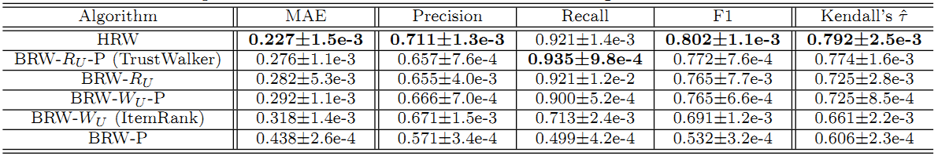
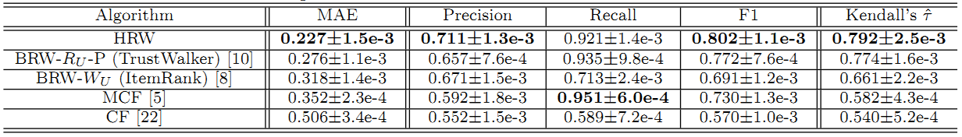
Good to Transfer?
Compare with RWR models
Compare with Baselines

Slide 49
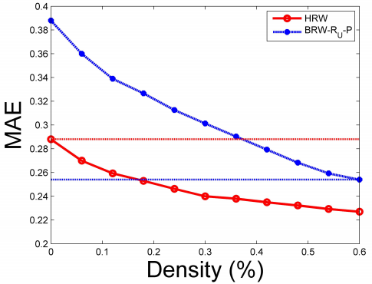
Good to Transfer? More Insights!
If we do transfer (from user-label domain), we need only ~30% to reach the same performance.
Advice: build more features to let new users provide more info.
0 user-post
100% user-label
35% user-post
60% user-post
18% user-post
100% user-label
Meng Jiang, Peng Cui, Fei Wang, Qiang Yang, Wenwu Zhu and Shiqiang Yang. Social Recommendation across Multiple Relational Domains. The 21st ACM International Conference on Information and Knowledge Management (CIKM), 2012.

Slide 50
Outline
Social contextual recommendation [CIKM’12+TKDE’14]
Cross-domain social recommendation [CIKM’12]
Behavior discovery and prediction [KDD’14]
Dense bipartite core detection [PAKDD’14]
Zombie follower detection [KDD’14]
Good user-item links
Bad user-user links

Slide 51
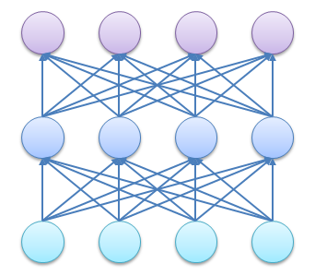

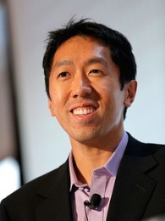
Human Behavior Pattern
Problem
Human behavior pattern discovery and prediction: significant for industry, national security and life experience.
Two basic characteristics of human behavior
Multi-faceted
Keyword/Topic
Affiliation/Institute/University
Write a paper
Author/Researcher

Slide 52


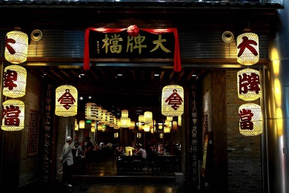
Human Behavior Pattern
Problem
Human behavior pattern discovery and prediction: significant for industry, national security and life experience.
Two basic characteristics of human behavior
Multi-faceted
Happy
birthday!☺
Phone
Text
Photo
Post a WeChat message
Location
WeChat user

Slide 53
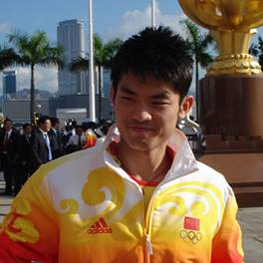
Human Behavior Pattern
Problem
Human behavior pattern discovery and prediction: significant for industry, national security and life experience.
Two basic characteristics of human behavior
Multi-faceted
Words in tweet
Congratulations
to the Champion!
Target user (the idol)
Mention your “idol”
Source user (using “@”)

Slide 54
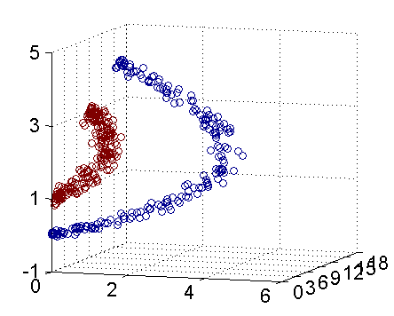
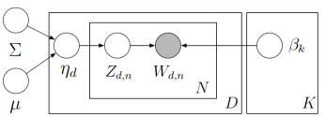


Human Behavior Pattern
Problem
Human behavior pattern discovery and prediction: significant for industry, national security and life experience.
Two basic characteristics of human behavior
Multi-faceted
Evolutionary
Write a paper
time

Slide 55
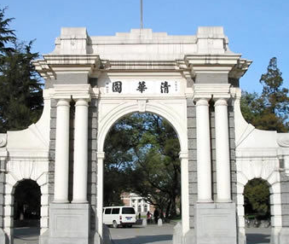

Human Behavior Pattern
Problem
Human behavior pattern discovery and prediction: significant for industry, national security and life experience.
Two basic characteristics of human behavior
Multi-faceted
Evolutionary
Post a WeChat message

Slide 56
Human Behavior Pattern
Problem
Human behavior pattern discovery and prediction: significant for industry, national security and life experience.
Two basic characteristics of human behavior
Multi-faceted
Evolutionary
How to model human behavior?
Tensor sequence.
How to do pattern discovery and prediction?
Tensor decomposition and completion.
time
t₃
t₂
item
t₁
user

Slide 57
Human Behavior Pattern
Challenges in high-order tensor decomposition
High sparsity
Write a paper: #author * #affiliation * #keyword
“@idol”: #(src) user * #(tgt) user * #word
High complexity
Long sequence of large tensors
Slow: decomposition at each time
time
t₃
t₂
item
t₁
user

Slide 58
Human Behavior Pattern
High sparsity: auxiliary knowledge as regularizers
Author - affiliation - keyword + co-authorship (author-author)
Src user - tgt user - word + social (user-user)
High complexity: update decomposition results (projection matrix) with new coming piece of data
user
item
…
user
item
time
t₃
t₂
item
time
t₁
item
user
user
t₁
t₂
t₃

Slide 59

FEMA: Flexible Evolutionary Multi-faceted Analysis
0~t
Δt
0~(t+Δt)
X
+
ΔX
item
item
user
user
Tensor Perturbation Theory
×
matricizing
item
cluster
λ
update
core tensor
X⁽¹⁾
user
cluster
user
decompose
user
cluster
？
X⁽²⁾
A⁽¹⁾
item
user
projection matrix
item
cluster
L⁽¹⁾
L⁽²⁾
item
A⁽²⁾
regularize
item
user
item

Slide 60



FEMA Algorithm
Approximation
Bound Guarantee

Slide 61




Leveraging Multi-faceted Information
“Who”-“What keyword”?
Use “Where” (affiliation)?
“Who”-“@Whom”?
Use “What” (tweet word)?
 | MAS (Data mining subset) |  | Tencent Weibo (January, 2011)
 | MAE | RMSE | MAE | RMSE
FEMA | 0.735 | 0.944 | 0.894 | 1.312
EMA | 0.794 | 1.130 | 0.932 | 1.556
EA | 0.979 | 1.364 | 1.120 | 1.873
Cross Validation
X
L
X
X

Slide 62


Leveraging Multi-faceted Information
 | MAS (Data mining subset) |  | Tencent Weibo (January, 2011)
 | MAE | RMSE | MAE | RMSE
FEMA | 0.735 | 0.944 | 0.894 | 1.312
EMA | 0.794 | 1.130 | 0.932 | 1.556
EA | 0.979 | 1.364 | 1.120 | 1.873
X
L
X
X

Slide 63




Leveraging Flexible Regularizations
“Who”-“Where”-“What keyword”?
“Who”-“@Whom”-“What”?
 | MAS (Data mining subset) |  | Tencent Weibo (January, 2011)
 | MAE | RMSE | MAE | RMSE
FEMA | 0.893 | 1.215 | 0.954 | 1.437
EMA | 0.909 | 1.466 | 0.986 | 1.698
DTA | 0.950 | 1.556 | 1.105 | 1.889
HOSVD | 1.047 | 1.618 | 1.220 | 2.054
CP | 1.055 | 1.612 | 1.243 | 2.117
Cross Validation
X
L
X

Slide 64


Leveraging Flexible Regularizations
“Who”-“Where”-“What keyword”?
“Who”-“@Whom”-“What”?
 | MAS (Data mining subset) |  | Tencent Weibo (January, 2011)
 | MAE | RMSE | MAE | RMSE
FEMA | 0.893 | 1.215 | 0.954 | 1.437
EMA | 0.909 | 1.466 | 0.986 | 1.698
X
L
X

Slide 65



Efficiency, Loss and Parameters
Re-decompose
updated matrices
Insensitive to
regularization weight
Evolutionary analysis:
update λ and a with ΔX
Evolutionary analysis:
update λ and a with ΔX
Re-decompose
updated matrices

Slide 66

First Cluster in MAS DM set

Slide 67

First Cluster in MAS DM set

Slide 68

First Cluster in MAS DM set

Slide 69

First Two Clusters in Tencent Weibo set

Slide 70

First Two Clusters in Tencent Weibo set

Slide 71


Demo: www.meng-jiang.com
Meng Jiang, Peng Cui, Fei Wang, Xinran Xu, Wenwu Zhu and Shiqiang Yang. FEMA: Flexible Evolutionary Multi-faceted Analysis for Dynamic Behavioral Pattern Discovery. The 20th ACM SIGKDD International Conference on Knowledge Discovery and Data Mining (KDD), 2014.

Slide 72
Outline
Social contextual recommendation [CIKM’12+TKDE’14]
Cross-domain social recommendation [CIKM’12]
Behavior discovery and prediction [KDD’14]
Dense bipartite core detection [PAKDD’14]
Zombie follower detection [KDD’14]
Good user-item links
Bad user-user links

Slide 73




Strange Behavior/Connectivity Patterns
Problem
Strange behavior on large graph: dense bipartite cores
Twitter/Weibo “who-follows-whom”

Slide 74


Strange Behavior/Connectivity Patterns
Problem
Strange behavior on large graph: dense bipartite cores
Twitter/Weibo “who-follows-whom”
eBay “who-reviews-what”

Slide 75


Strange Behavior/Connectivity Patterns
Problem
Strange behavior on large graph: dense bipartite cores
Twitter/Weibo “who-follows-whom”
eBay “who-reviews-what”
Facebook “who-likes-page”

Slide 76



Strange Behavior/Connectivity Patterns
Problem
Strange behavior on large graph: dense bipartite cores
Twitter/Weibo “who-follows-whom”
eBay “who-reviews-what”
Facebook “who-likes-page”
“Lockstep” behavior
Given
Usually we have
reordering

Slide 77

Strange Behavior/Connectivity Patterns
Challenges
“Lockstep” behavior
Overlapping

Slide 78

Strange Behavior/Connectivity Patterns
Challenges
“Lockstep” behavior
Overlapping
Camouflage

Slide 79

Strange Behavior/Connectivity Patterns
Challenges
“Lockstep” behavior
Overlapping
Camouflage
Fame

Slide 80
SVD Reminder
followee
1
×
×
follow
follower
×
2
×
Graph Structure
Adjacency Matrix
Pairs of singular vectors:
SVD: A=USV^{T}
followee
U₂
V₂
U₁U₂
…
V₁V₂
U₁
V₁
follower
“Spectral Subspace Plot”

Slide 81


Lockstep and Spectral Subspace Plot
Case #0: No lockstep behavior in random power law graph of 1M nodes, 3M edges
Random “Scatter”
Adjacency Matrix
Spectral Subspace Plot

Slide 82

Lockstep and Spectral Subspace Plot
Case #1: non-overlapping lockstep
“Blocks” “Rays”
Adjacency Matrix
Spectral Subspace Plot

Slide 83

Lockstep and Spectral Subspace Plot
Case #2: non-overlapping lockstep
“Blocks; low density” Elongation
Adjacency Matrix
Spectral Subspace Plot

Slide 84

Lockstep and Spectral Subspace Plot
Case #3: non-overlapping lockstep
“Camouflage” (or “Fame”) Tilting “Rays”
Adjacency Matrix
Spectral Subspace Plot

Slide 85

Lockstep and Spectral Subspace Plot
Case #3: non-overlapping lockstep
“Camouflage” (or “Fame”) Tilting “Rays”
Adjacency Matrix
Spectral Subspace Plot

Slide 86

Lockstep and Spectral Subspace Plot
Case #4: ? lockstep
“?” “Pearls”
Adjacency Matrix
Spectral Subspace Plot
?

Slide 87
Lockstep and Spectral Subspace Plot
Case #4: overlapping lockstep
“Staircase” “Pearls”
Adjacency Matrix
Spectral Subspace Plot

Slide 88
Algorithm
Step 1: Seed selection
Spot “Rays” and “Pearls”
Catch seed followers
Step 2: Belief Propagation
Blame followees with strange followers
Blame followers with strange followees

Slide 89

Automatically Spot “Rays” and “Pearls”
Spectral
Subspace Plot
Polar Coordinate
Transform
Histograms

Slide 90

BP-based Algorithm
Blame followees with strange followers
Blame followers with strange followees

Slide 91




Real Data
“Rays”
“Block”
“Pearls”
“Staircase”

Slide 92

Real Data
“Rays”
“Block”

Slide 93
Real Data
“Pearls”
3,188
in F₁
7,210
in F₂
2,457
in F₃
“Staircase”
E₁
E₂
E₃
E₄
“F-E” | F₁-… | F₂-… | F₃-…
Density | 91.3% | 92.6% | 89.1%

Slide 94
Real Data
“Pearls”
“Staircase”
“Staircase”

Slide 95

Real Data
Spikes on the out-degree distribution
×
×

Slide 96

Synthetic Data
Inject lockstep behavior with “camouflage”
perfect

Slide 97

Synthetic Data
Inject overlapping lockstep behavior
perfect
Meng Jiang, Peng Cui, Alex Beutel, Christos Faloutsos and Shiqiang Yang. Inferring Strange Behavior from Connectivity Pattern in Social Networks.The 18th Pacific-Asia Conference on Knowledge Discovery and Data Mining (PAKDD), 2014.

Slide 98
Outline
Social contextual recommendation [CIKM’12+TKDE’14]
Cross-domain social recommendation [CIKM’12]
Behavior discovery and prediction [KDD’14]
Dense bipartite core detection [PAKDD’14]
Zombie follower detection [KDD’14]
Good user-item links
Bad user-user links

Slide 99

Buy Twitter Followers
(Fake) friends with (Real) benefits
I paid $5 for 4,000 Twitter followers, and here’s what I found
https://medium.com/i-data/fake-friends-with-real-benefits-eec8c4693bd3

Slide 100

Buy Twitter Followers
(Fake) friends with (Real) benefits
I paid $5 for 4,000 Twitter followers, and here’s what I found
https://medium.com/i-data/fake-friends-with-real-benefits-eec8c4693bd3

Slide 101

Buy Twitter Followers
(Fake) friends with (Real) benefits
I paid $5 for 4,000 Twitter followers, and here’s what I found
https://medium.com/i-data/fake-friends-with-real-benefits-eec8c4693bd3

Slide 102

Buy Twitter Followers
(Fake) friends with (Real) benefits
I paid $5 for 4,000 Twitter followers, and here’s what I found
https://medium.com/i-data/fake-friends-with-real-benefits-eec8c4693bd3

Slide 103
Zombie Follower Detection
Challenges
Scalability: How to catch zombie followers from large graphs of millions of nodes and billions of edges?

Slide 104



Out-degree Distribution
Power-law distribution (bipartite graph)
DBLP Author-publication | Epinions User-rates-product | Delicious User-tag
http://konect.uni-koblenz.de/networks/

Slide 105



Out-degree Distribution
Power-law distribution (directed graph)
Wikipedia Page-links-to-page | Baidu Page-links-to-page | Google Page-links-to-page
http://konect.uni-koblenz.de/networks/

Slide 106



Out-degree Distribution
Power-law distribution (directed graph - social network)
LiveJournal User-user | Flickr User-user | Twitter Who-follows-whom
http://konect.uni-koblenz.de/networks/

Slide 107


What We Have…
Twitter (2009) 41 million users | Tencent Weibo (2011) 117 million users

Slide 108
Zombie Follower Detection
Challenges
Scalability: How to catch zombie followers from large graphs of millions of nodes and billions of edges? Can we explain the spikes on out-degree distributions?

Slide 109


Zombie Follower Detection
Challenges
Scalability: How to catch zombie followers from large graphs of millions of nodes and billions of edges? Can we explain the spikes on out-degree distributions?
Camouflage: fake profile, no or little content, extra performance

Slide 110


Zombie Follower Detection
Challenges
Scalability: How to catch zombie followers from large graphs of millions of nodes and billions of edges? Can we explain the spikes on out-degree distributions?
Camouflage: fake profile, no or little content, extra performance

Slide 111


Zombie Follower Detection
Challenges
Scalability: How to catch zombie followers from large graphs of millions of nodes and billions of edges? Can we explain the spikes on out-degree distributions?
Camouflage: fake profile, no or little content, extra performance

Slide 112
Zombie Follower Detection
Challenges
Scalability: How to catch zombie followers from large graphs of millions of nodes and billions of edges? Can we explain the spikes on out-degree distributions?
Camouflage: fake profile, no or little content, extra performance
Previous approaches
Label (+1,-1) | Out-degree | In-degree | #tweet | #url in tweets | #hashtag in tweets
Graph-based features
Content-based features
0, 0, 0 sorry…
classifier

Slide 113


Graph-based Feature Space
Followers
Followees
We spot some outliers, but are they suspicious?
Answer: suspicious behavior patterns create suspicious graph structure

Slide 114

Compare Zombie Follower and Normal User
X = @Buy_AB22: a zombie follower with 20 followees
Y = a random user with 20 followees
Suspicious behavior: similar with each other, different from normal.
X’s followees
Y’s followees

Slide 115


Suspicious Behavior Pattern
Behavior-based features
Synchronicity: similarity between one’s followees
Normality: similarity between one’s followee and everyone
Theorem For any distribution, there is a parabolic lower limit in the synchronicity-normality plot.
Feature vector

Slide 116

Synchronicity-Normality Plot
Use CatchSync to catch Zombie follower
Synchronized and abnormal behavior
Big synchronicity and small normality; away from the densest
Last step: develop a distance-based anomaly detection method!
X’s followees
Y’s followees

Slide 117


Goal 1: Do we catch the anomalies?
Graph-based feature space
Followers
Followees

Slide 118


Goal 1: Do we catch the anomalies?
Out-degree distribution
Twitter

Slide 119

Goal 1: Do we catch the anomalies?
Out-degree distribution
Tencent Weibo

Slide 120



Goal 2: Do we catch suspicious users?
Manually label 1,000 users as suspicious or not by reading their pages (profiles, tweets, followers, followings, etc.)
Better than content-based method SPOT
Complementary with SPOT
Twitter
Tencent
Weibo

Slide 121




Goal 3: Is CatchSync anti-camouflage?
Camouflage
+10%, +50%
+random, +popular
+ camouflage”
Hide in feature space
Show in SN-plot

Slide 122



Goal 3: Is CatchSync anti-camouflage?
Accuracy:
Random “Camouflage”:
Popular “Camouflage”:
Meng Jiang, Peng Cui, Alex Beutel, Christos Faloutsos and Shiqiang Yang. CatchSync: Catching Synchronized Behavior in Large Directed Graphs. The 20th ACM SIGKDD International Conference on Knowledge Discovery and Data Mining (KDD), 2014.
Meng Jiang, Peng Cui, Alex Beutel, Christos Faloutsos and Shiqiang Yang. Detecting Suspicious Following Behavior in Multimillion-Node Social Networks. The 23rd international conference on World Wide Web companion (WWW), 2014. (Poster)

Slide 123
Outline
Social contextual recommendation [CIKM’12+TKDE’14]
Cross-domain social recommendation [CIKM’12]
Behavior discovery and prediction [KDD’14]
Dense bipartite core detection [PAKDD’14]
Zombie follower detection [KDD’14]
Good user-item links
Bad user-user links

Slide 124
References
Meng Jiang, Peng Cui, Alex Beutel, Christos Faloutsos and Shiqiang Yang. CatchSync: Catching Synchronized Behavior in Large Directed Graphs. The 20th ACM SIGKDD International Conference on Knowledge Discovery and Data Mining (KDD), 2014.
Meng Jiang, Peng Cui, Fei Wang, Xinran Xu, Wenwu Zhu and Shiqiang Yang. FEMA: Flexible Evolutionary Multi-faceted Analysis for Dynamic Behavioral Pattern Discovery. The 20th ACM SIGKDD International Conference on Knowledge Discovery and Data Mining (KDD), 2014.
Meng Jiang, Peng Cui, Alex Beutel, Christos Faloutsos and Shiqiang Yang. Inferring Strange Behavior from Connectivity Pattern in Social Networks.The 18th Pacific-Asia Conference on Knowledge Discovery and Data Mining (PAKDD), 2014.
Meng Jiang, Peng Cui, Alex Beutel, Christos Faloutsos and Shiqiang Yang. Detecting Suspicious Following Behavior in Multimillion-Node Social Networks. The 23rd international conference on World Wide Web companion (WWW), 2014. (Poster)
Meng Jiang, Peng Cui, Fei Wang, Wenwu Zhu and Shiqiang Yang. Scalable Recommendation with Social Contextual Information. IEEE Transactions on Knowledge and Data Engineering (TKDE), 2014.
Meng Jiang, Peng Cui, Rui Liu, Qiang Yang, Fei Wang, Wenwu Zhu and Shiqiang Yang. Social Contextual Recommendation. The 21st ACM International Conference on Information and Knowledge Management (CIKM), 2012.
Meng Jiang, Peng Cui, Fei Wang, Qiang Yang, Wenwu Zhu and Shiqiang Yang. Social Recommendation across Multiple Relational Domains. The 21st ACM International Conference on Information and Knowledge Management (CIKM), 2012.
Lu Liu, Feida Zhu, Meng Jiang, Jiawei Han, Lifeng Sun, Shiqiang Yang. Mining Diversity on Social Media Networks. Multimedia Tools and Applications, 2012.
Lu Liu, Jie Tang, Jiawei Han, Meng Jiang, Shiqiang Yang. Mining Topic-Level Influence in Heterogeneous Networks. The 19th ACM International Conference on Information and Knowledge Management (CIKM), 2010.

Slide 125







Acknowledgements
Tsinghua University
Carnegie Mellon University
Shiqiang Yang
Wenwu Zhu
Peng Cui
Lu Liu
IBM T. J. Watson Research Center
Christos Faloutsos
Alex Beutel
Fei Wang

Slide 126

Thank you!
Welcome to visit my homepage:
http://www.meng-jiang.com
❤ New friends ❤ Discussions ❤ Collaborations

